Slide 1
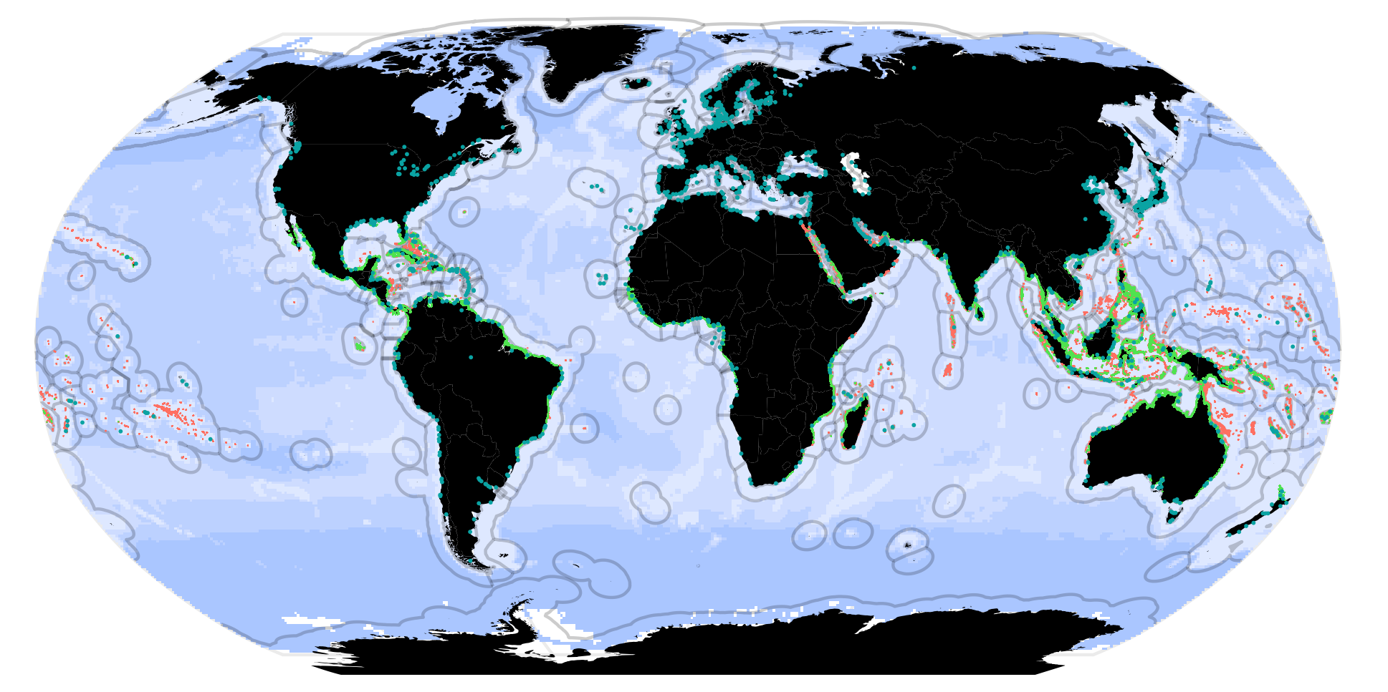
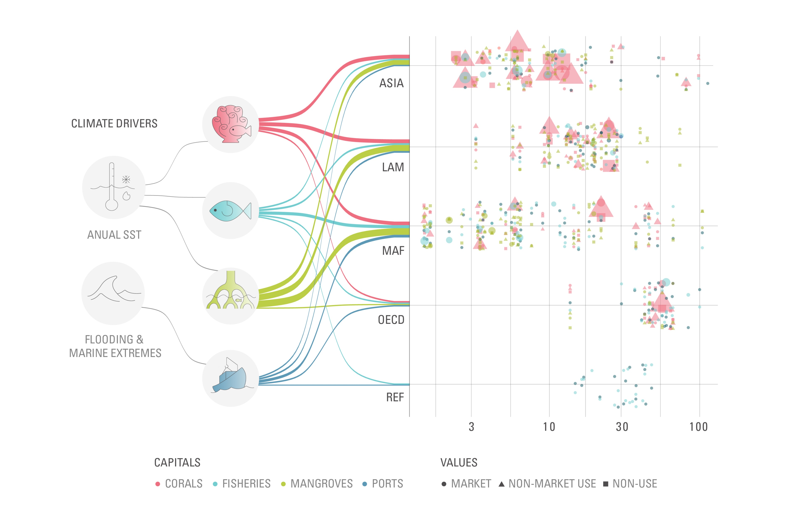
a. Global blue capital
Corals
Fish
Mangroves
Ports
EEZ
b. Climate impacts on values of blue capital across regions
GDP per capita (Thousand USD)

Slide 2
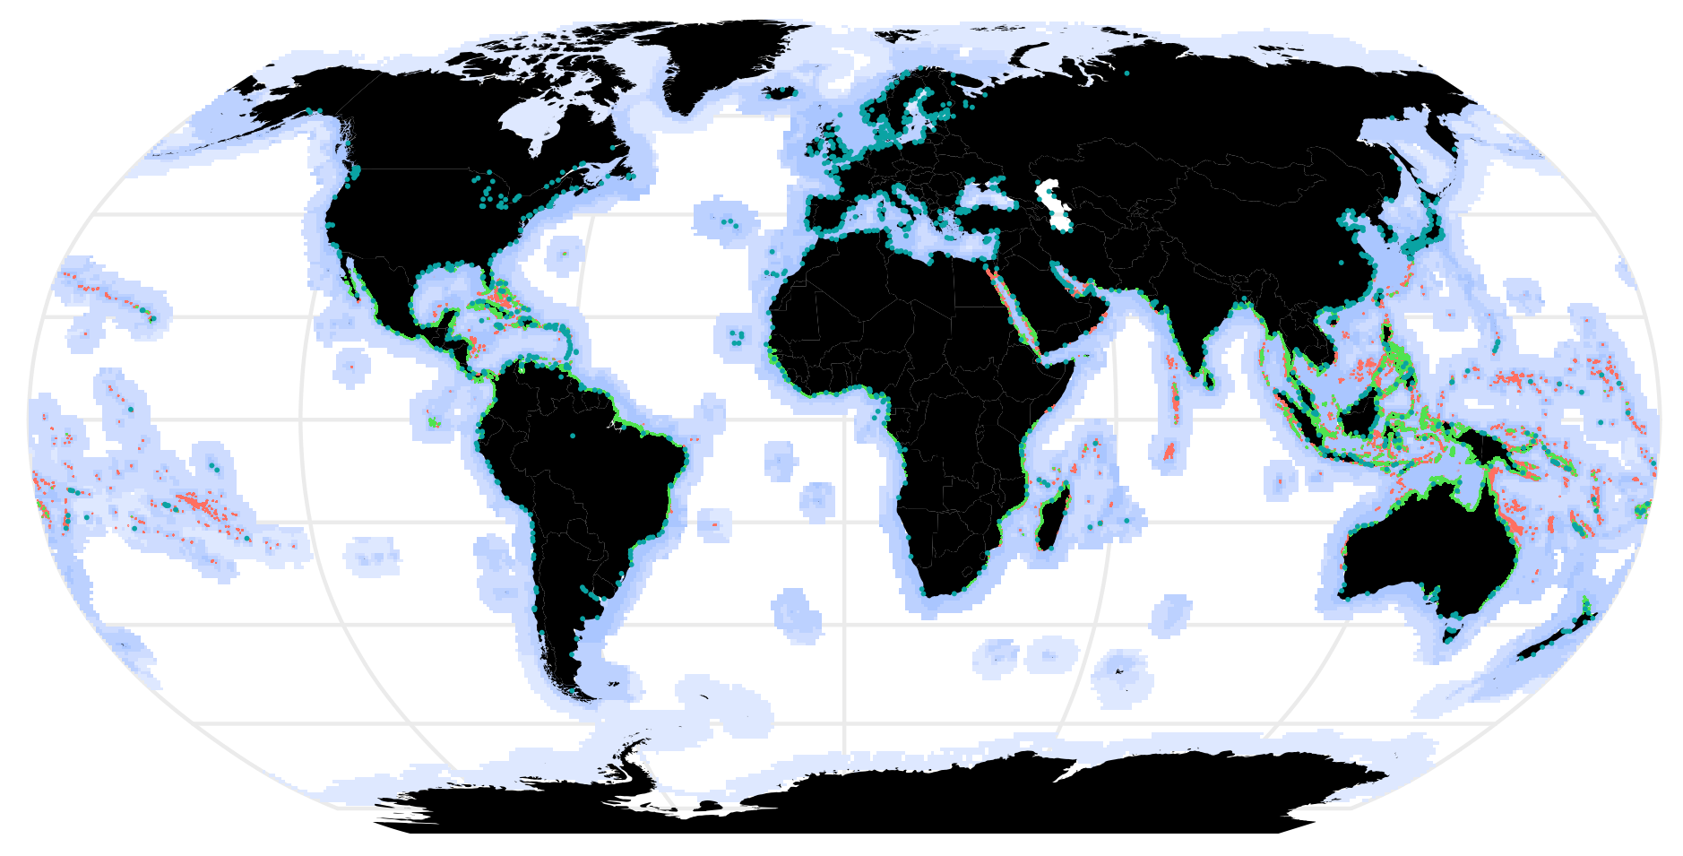
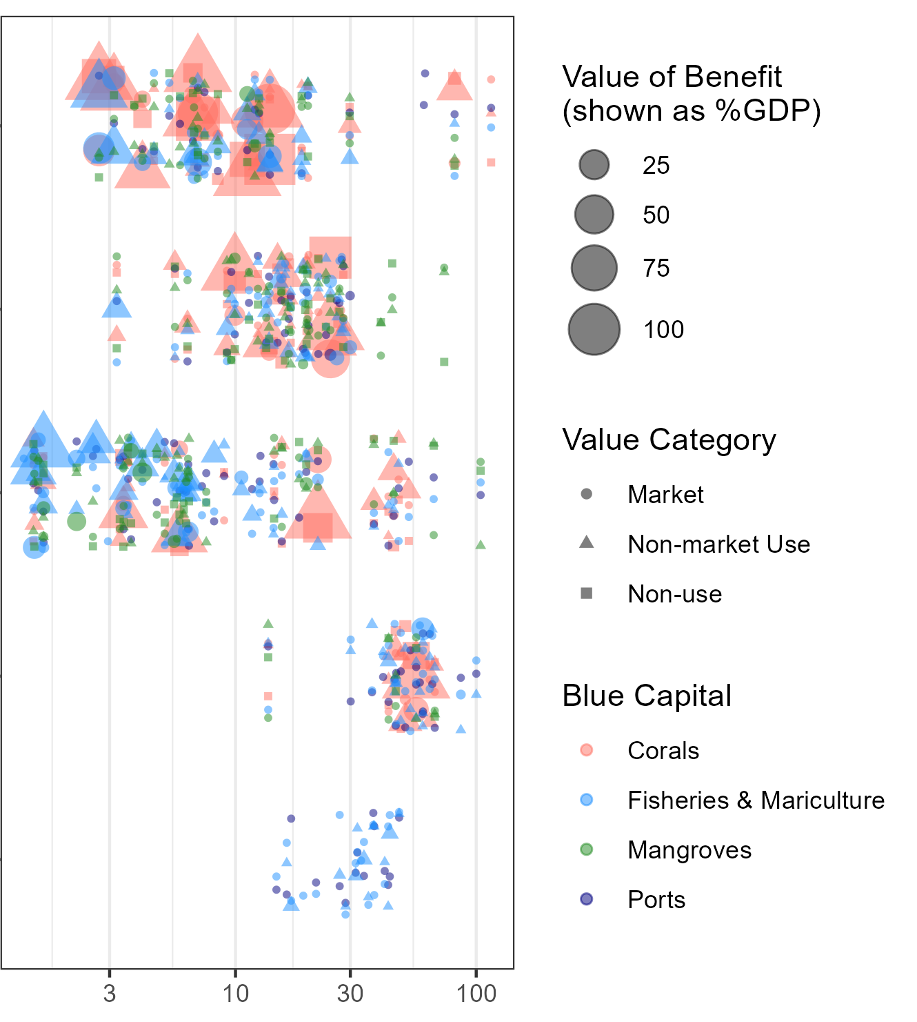
a. Global blue capital
Corals
Fish
Mangroves
Ports
b. Climate impacts on values of blue capital across regions
Ocean-based capital
Climate drivers
GDP per capita (Thousand USD)

Slide 3
a. Global blue capital
Corals
Fish
Mangroves
Ports
b. Climate impacts on values of blue capital across regions
Ocean-based annual benefits in 2020
Ocean-based capital
Climate drivers
GDP per capita (Thousand USD)

